Slide 1
Mind-Body Connection
Confidence vs Feelings
Mental Performance Coach
Kris Goodman
Notes:
Introduction & Why mental performance
Benefits of mental toughness: adaptability, present moment focus, motivation, composure,

Slide 2
Understanding Our Feelings & Mind
They aren’t permanent
They can be overrated
60k-80k thoughts per day
The mind tells the body what to do

Slide 3
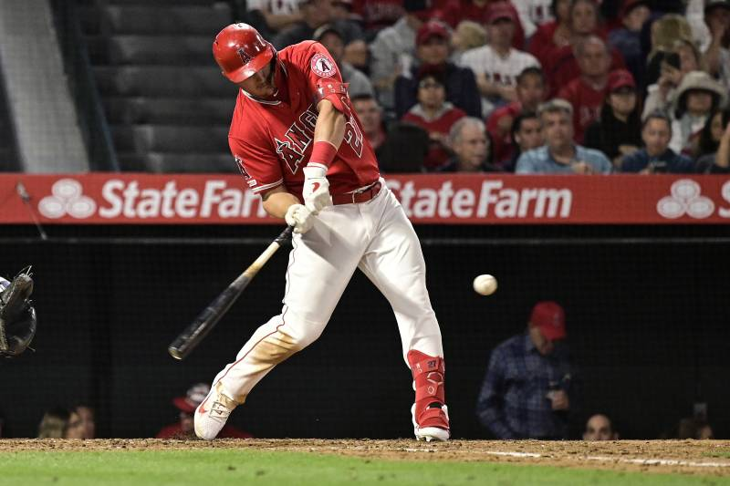
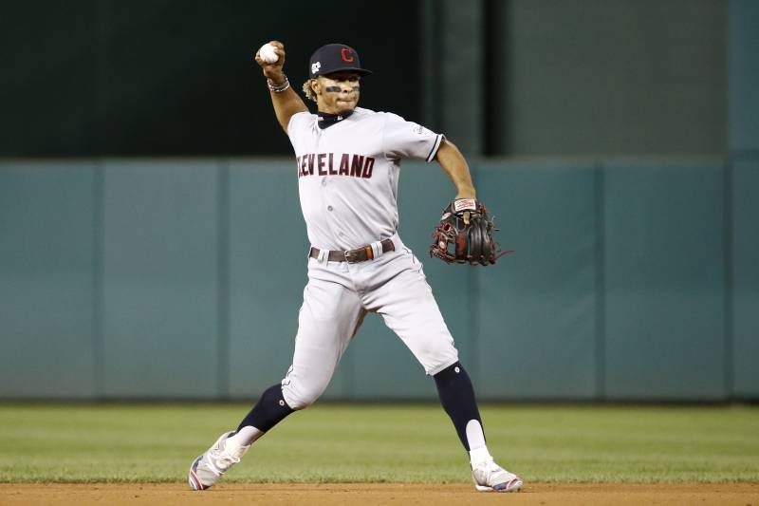
Communication through Our Body Language
93% of our communication is non-verbal
Does your body language impact your opponent?
Notes:
Body language study=regardless how we feel we need to act a certain way.

Slide 4
Relating confidence to how we ACT
Confidence should be rooted in something concrete
Attention to the task
Carrying yourself with big BL
Talking productively

Slide 5
Exit Ticket
Relate confidence to actions
Actions ←→Thoughts
Attention to the task
Carry yourself with big BL
Talk productively
ow

Slide 6
Questions…?
Twitter: @krisgoodman_
Kgoodman@raysbaseball.com

