Slide 1

KYLE ATTL
Swing Profiles – Power / Contact
  What is more important …?
What you could do …?
What should I have my player do …?

Slide 2

SWING PROFILES
POWER
CONTACT
60
45

Slide 3
POWER PROFILE
Raw Power
Bat Speed
75mph vs 55mph
Power Efficiency
Rotational Acceleration
25G vs 8G

Slide 4
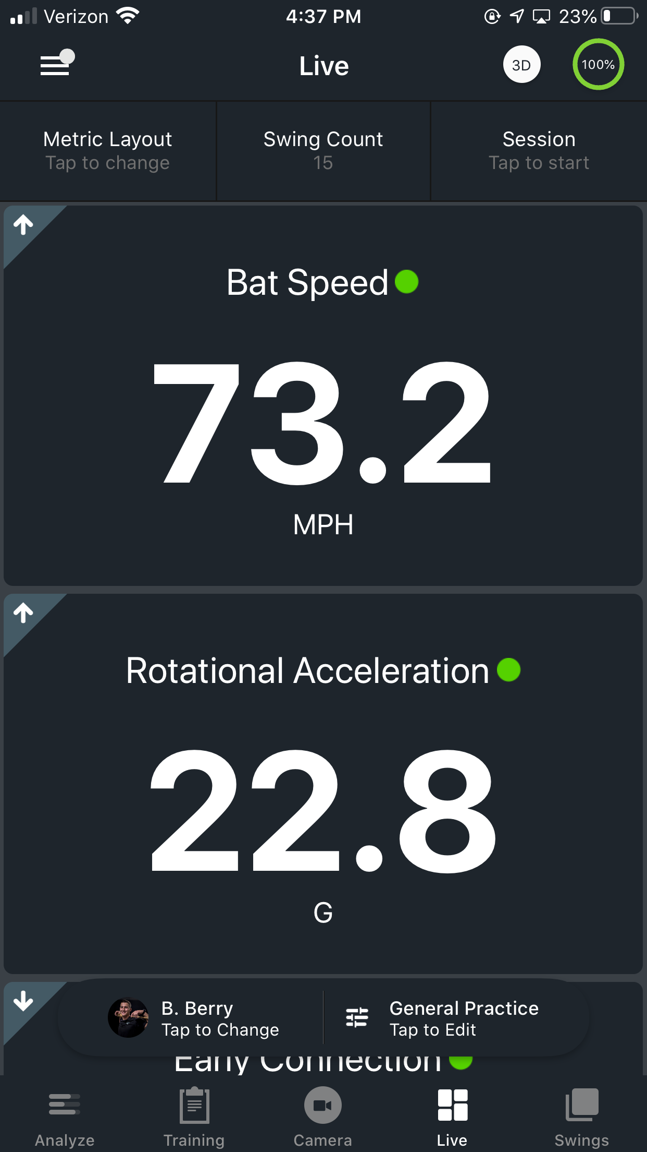
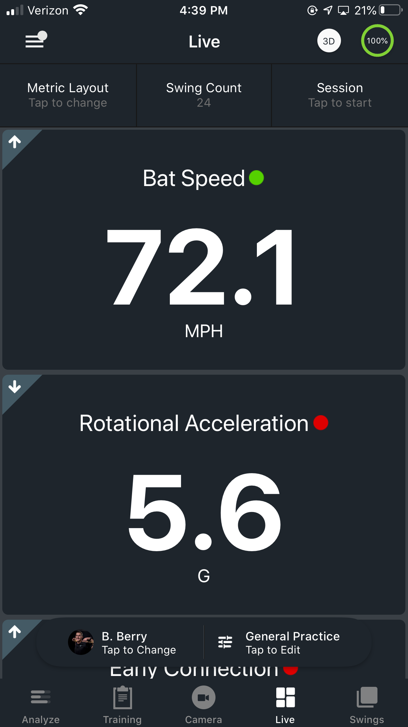

Rotational Acceleration vs. Bat Speed
What is more important …?
Bat Speed is the pre req
  E.g. Pitching and velo
  Lower levels
Rotational Acceleration Ceiling
  Can you do it fast enough?
  Light on dashboard for sequencing (K-vest)
Notes:
1) This is an example of 2 hitters who have very similar bat speeds, but build them much differently (as seen by their Rotational Acceleration values)
2) The player with higher Rotational Acceleration (13 gs) builds the bat speed quicker and likely sequences better than the player with 6 gs of Rotational Acceleration
3) 2 cars can both be traveling at the same speed on the freeway (Bat speed), but how quickly they are able to acceleration from 0-60 is an indicator of their engine (Rotational Acceleration)

Slide 5
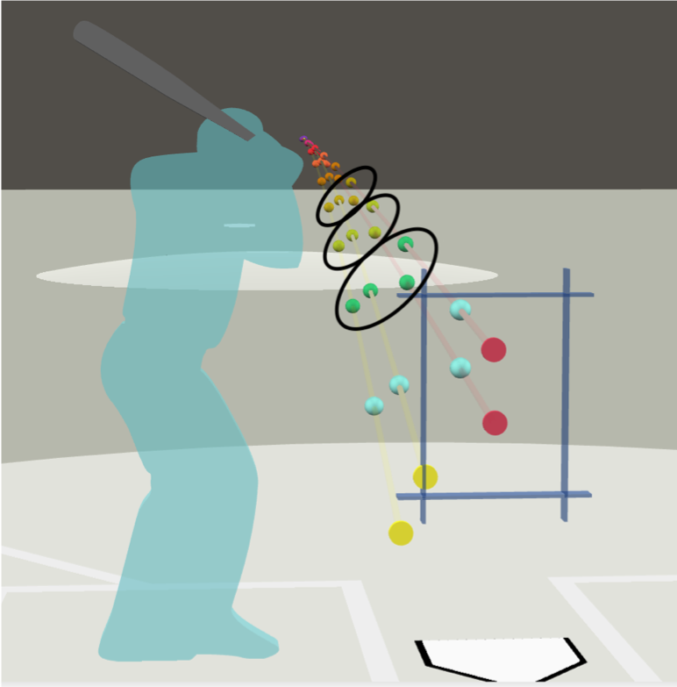
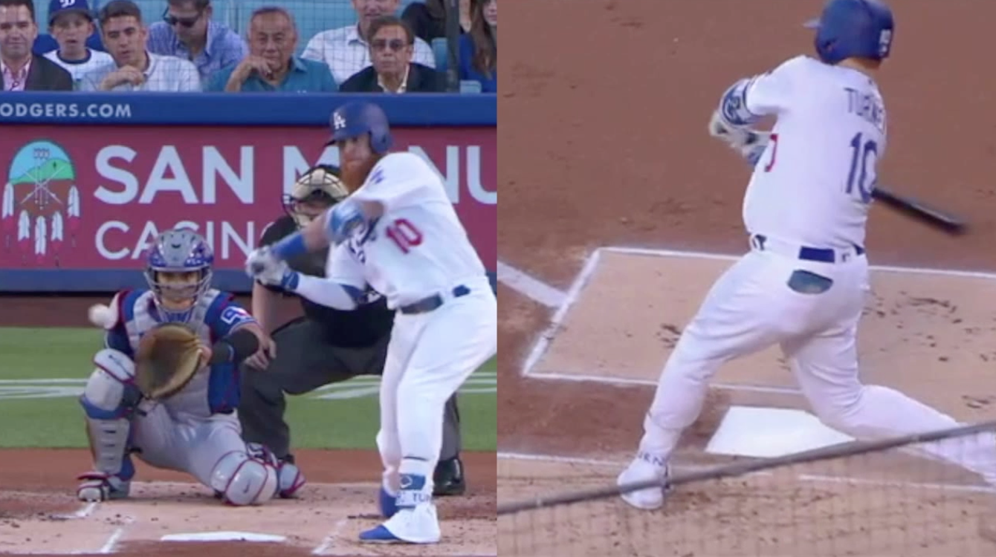
Rotational Acceleration and Performance
1
2
3

Slide 6
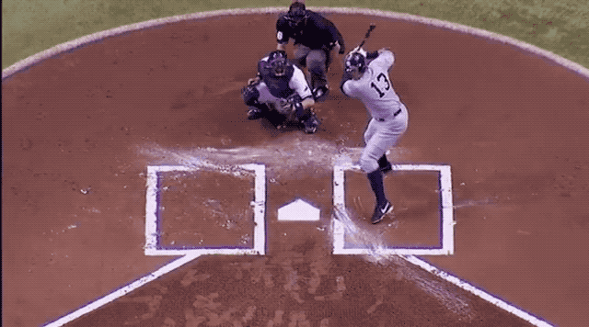
Rotational Acceleration Measured
The 0 – 60 time of your swing (Engine)
Measures what the bat feels first
Notes:
1) Rotational Acceleration measures how quickly you build bat speed & is a great indicator of how well a hitter sequences
2) Players who sequence well (hips then torso, then shoulders, then arms, hands, bat) will have higher Rotational Acceleration values because it is physically impossible to register high values without proper sequencing
3) High Rotational Acceleration results in hitters with dynamic power, who don’t sacrifice consistent contact for power & have the ability to spread power to all fields
4) High Rotational Acceleration also allows for a more adjustable swing to different pitch types and locations because the hands typically aren't committed until late in the swing

Slide 7
EVALUATING HITTERS
POWER
CONTACT
65
45

Slide 8
CONTACT PROFILE
Swing Path
On Plane Efficiency
80% vs 50%
Swing Direction
Attack Angle
+9° vs -7°

Slide 9
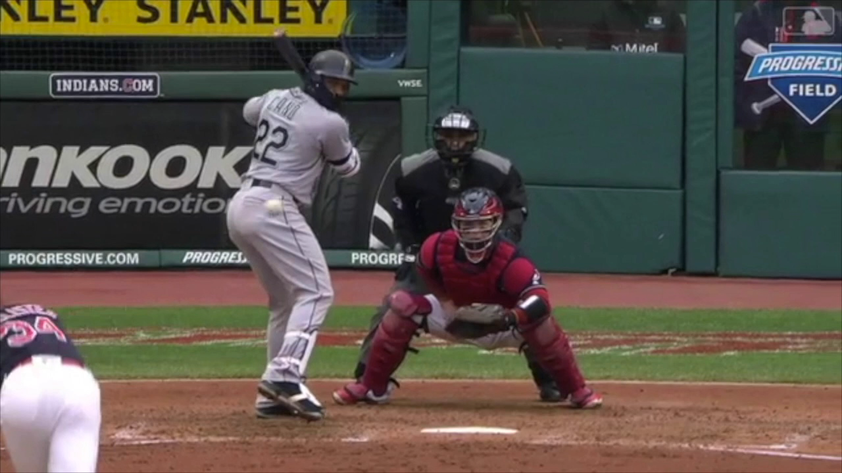
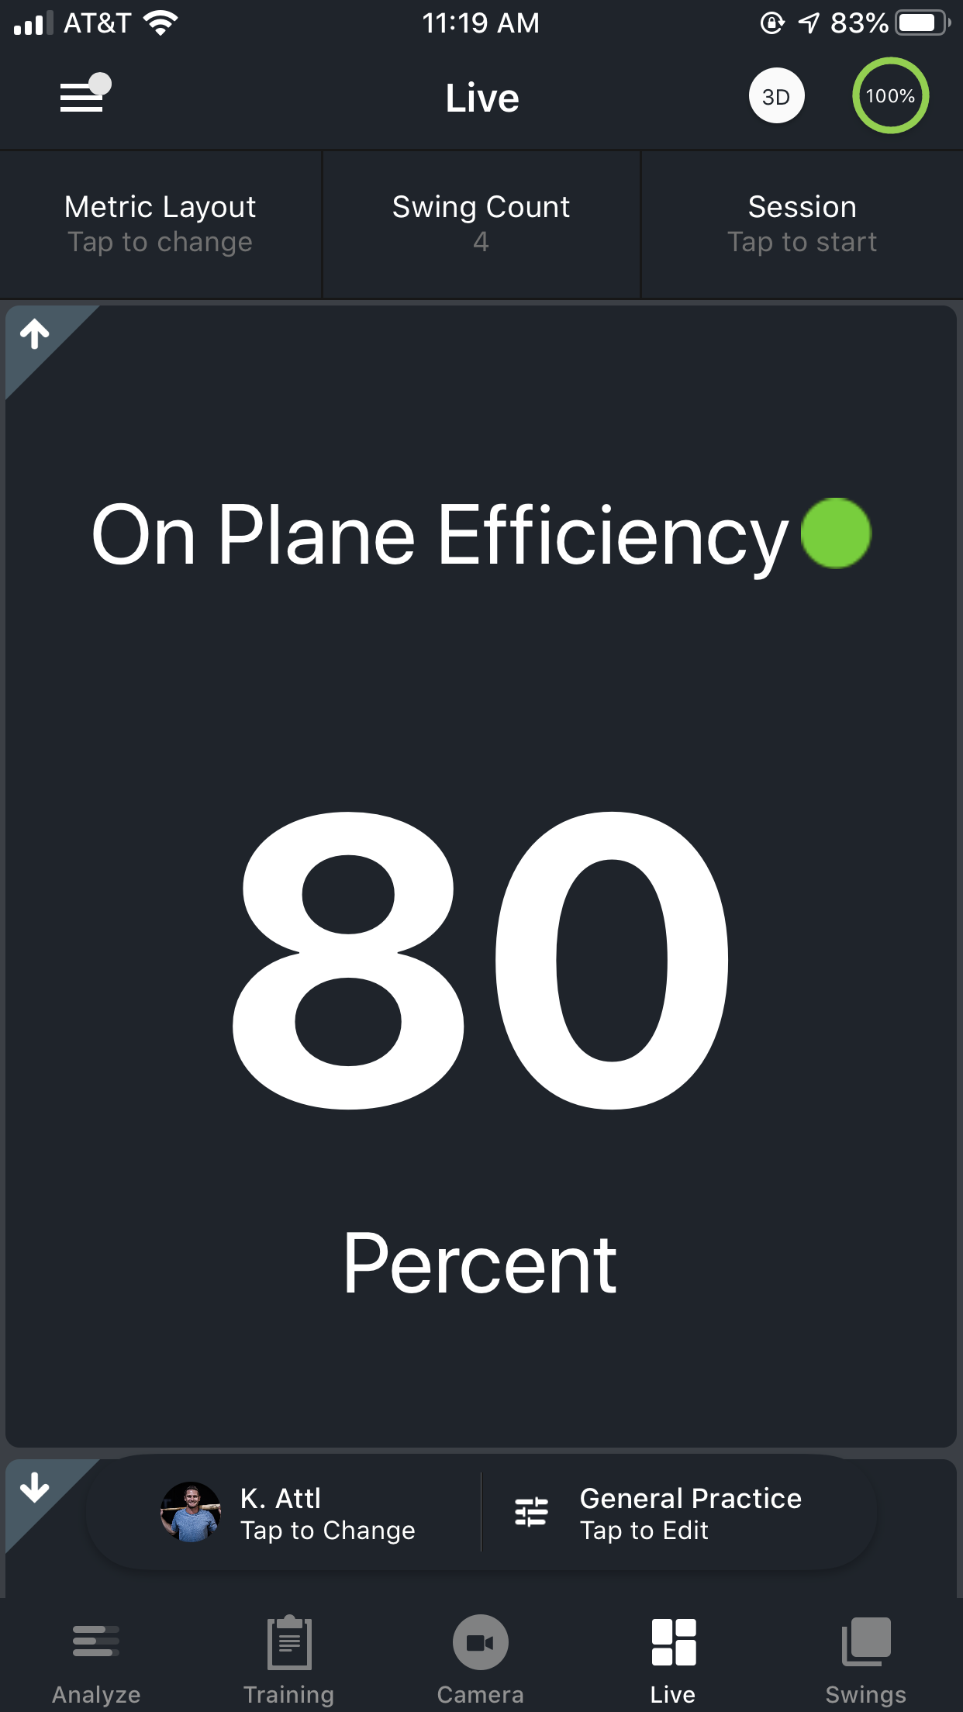
On-Plane Efficiency – Swing Path
Swing Plane
Target Range: 70% or above
Notes:
On-Plane Efficiency measures the hitter’s ability to stay on plane by building speed in the right direction (towards the pitch)
The higher your on-plane efficiency the better (%)
Each swing has its own swing plane (defined by the vertical bat angle at impact)
Our sensor measures how long you are on that swing plane which has shown to result in more consistent hard contact & barreled balls
Hitters with high on-plane efficiency typically have a more repeatable swing with consistent launch angles and consistent exit velocities

Slide 10
On-Plane Efficiency – Swing Path
Pitch location dictates the Swing Plane
Notes:
On-Plane Efficiency measures the hitter’s ability to stay on plane by building speed in the right direction (towards the pitch)
The higher your on-plane efficiency the better (%)
Each swing has its own swing plane (defined by the vertical bat angle at impact)
Our sensor measures how long you are on that swing plane which has shown to result in more consistent hard contact & barreled balls
Hitters with high on-plane efficiency typically have a more repeatable swing with consistent launch angles and consistent exit velocities
Max Exit Velo and Avg. Exit Velocity

Slide 11
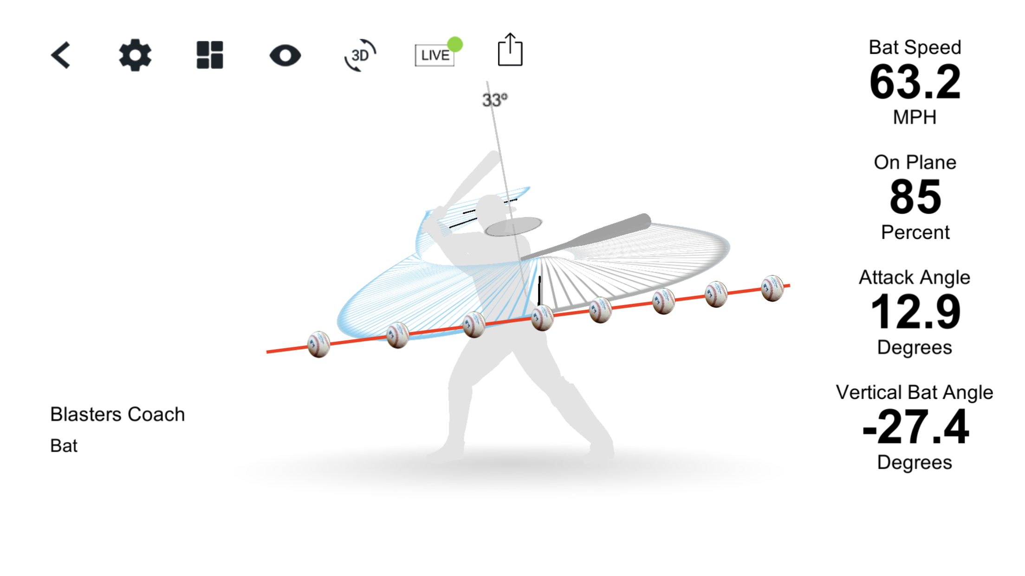
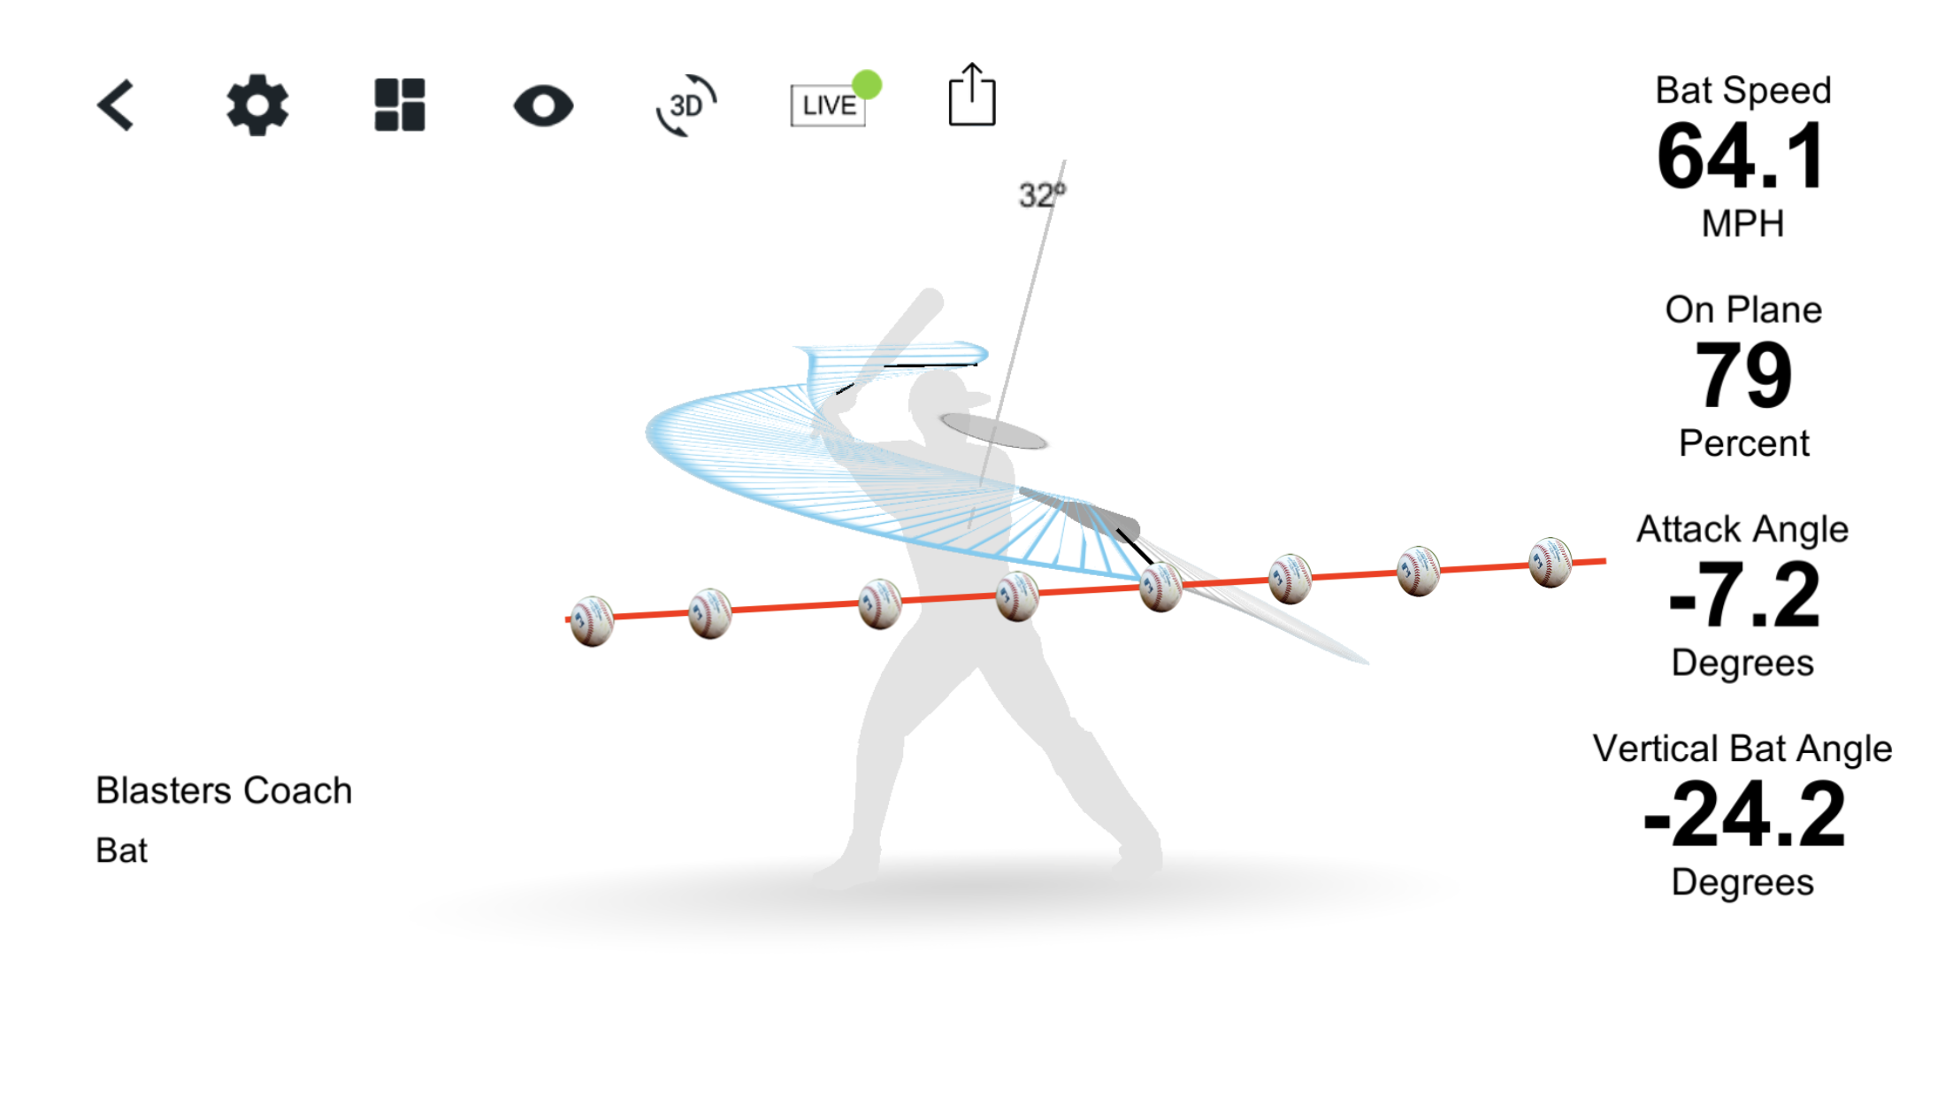
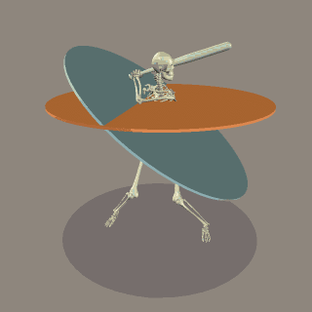
On-Plane Efficiency & Attack Angle
Notes:
Because our swing plane has no reference to the pitch (sensor on the bat), it’s important to ensure to match your swing plane to the incoming pitch
The average pitch comes in between -6 and -15 degrees, so in order to maximize the probability of contact you would like to match that with your attack angle
These 2 examples show 2 hitters with high on-plane efficiency. The first matches the pitch plane with their attack angle, the other doesn’t. You can see the difference in the opportunities for contact.

Slide 12
POWER
Raw Power
Bat Speed: 75 mph
Power Eff:
Rotational Acceleration: 20G
CONTACT
Swing Path
On Plane Efficiency: 85%
Swing Direction
Attack Angle: 5° to 12°

Slide 13

What Can Coach Do …?
Share Data at a single point in time
Show data over time
Drive Development / Maintenance Plan

Slide 14
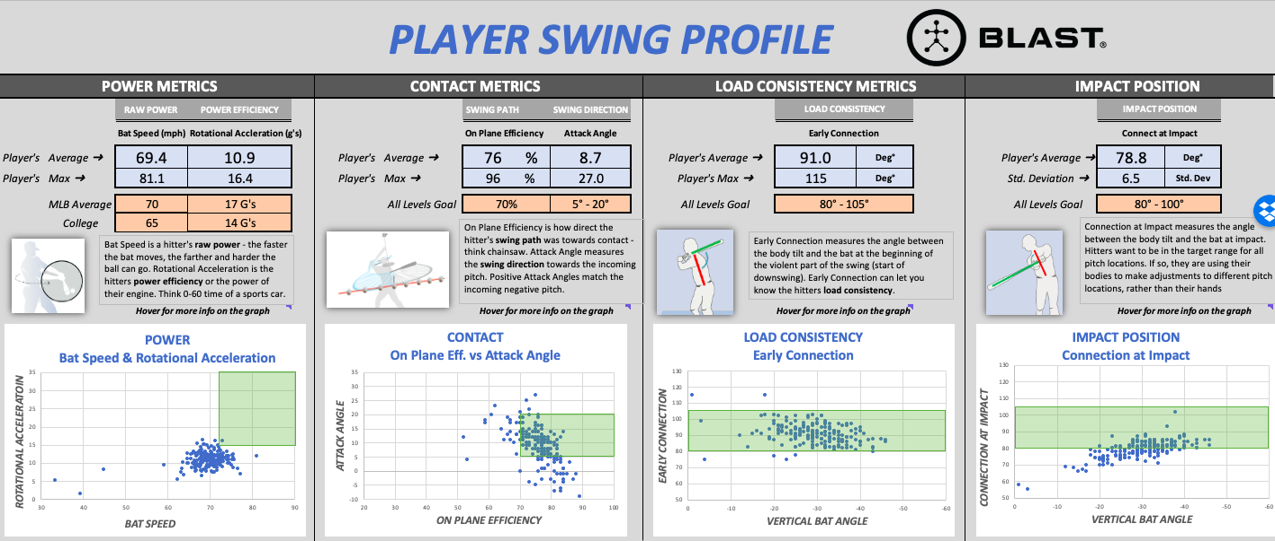
Player 1

Slide 15
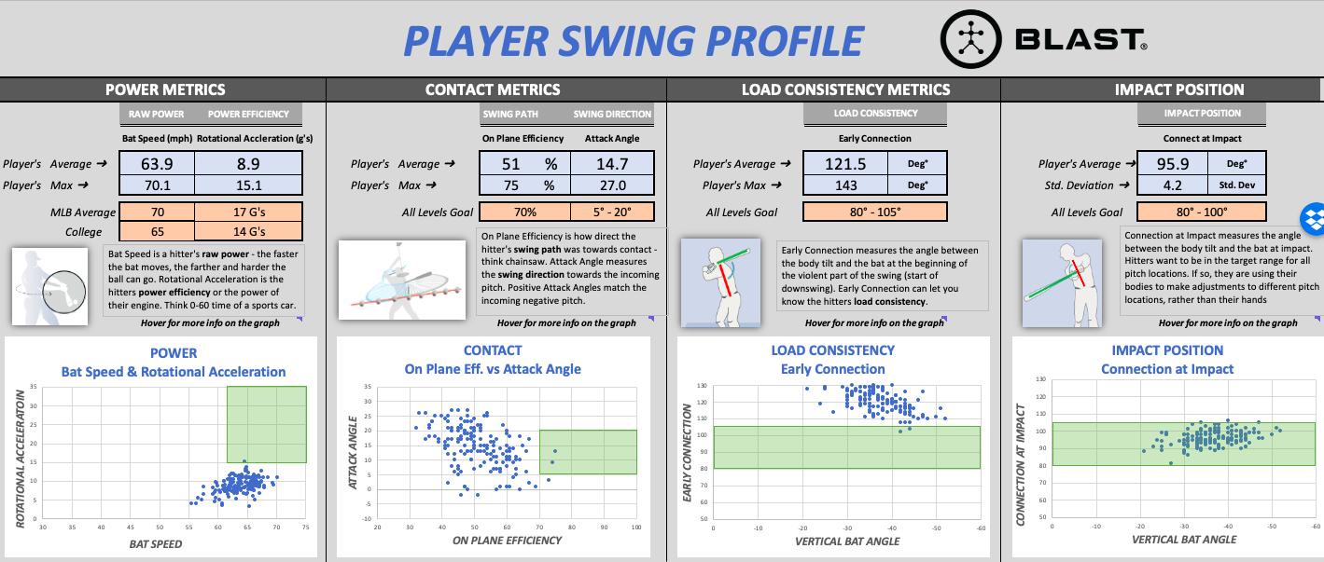
Player 2

Slide 16
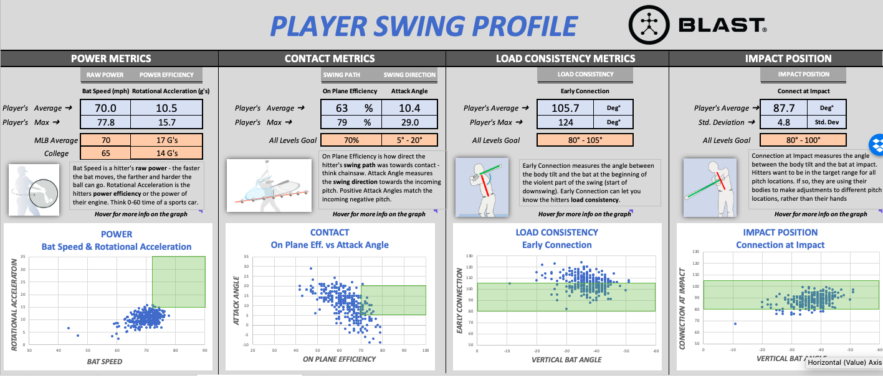
Player 3

Slide 17
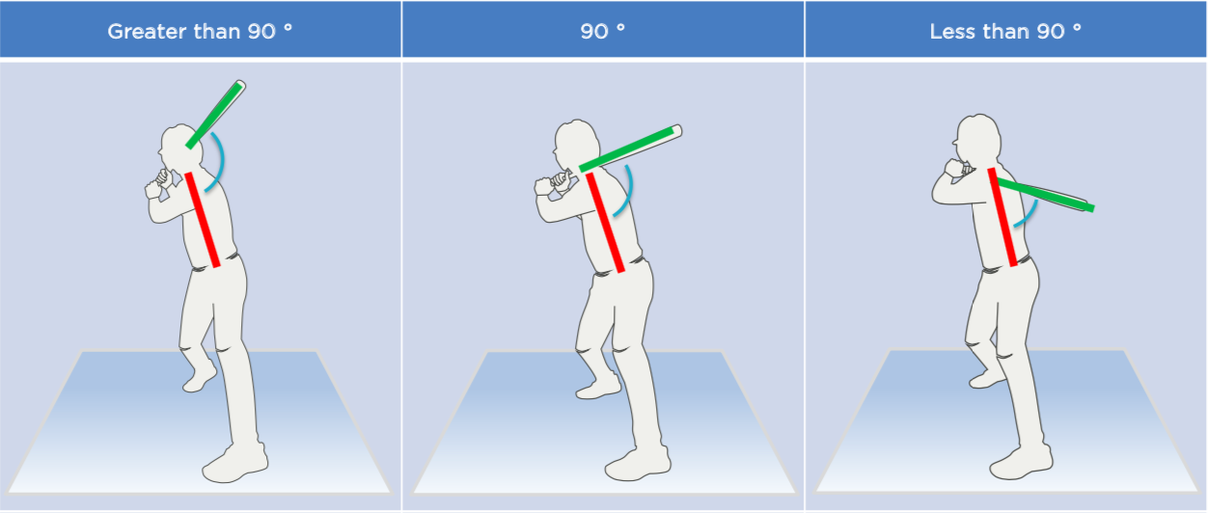
Early Connection – Consistent Load
Target Range: 80° - 105°

Slide 18
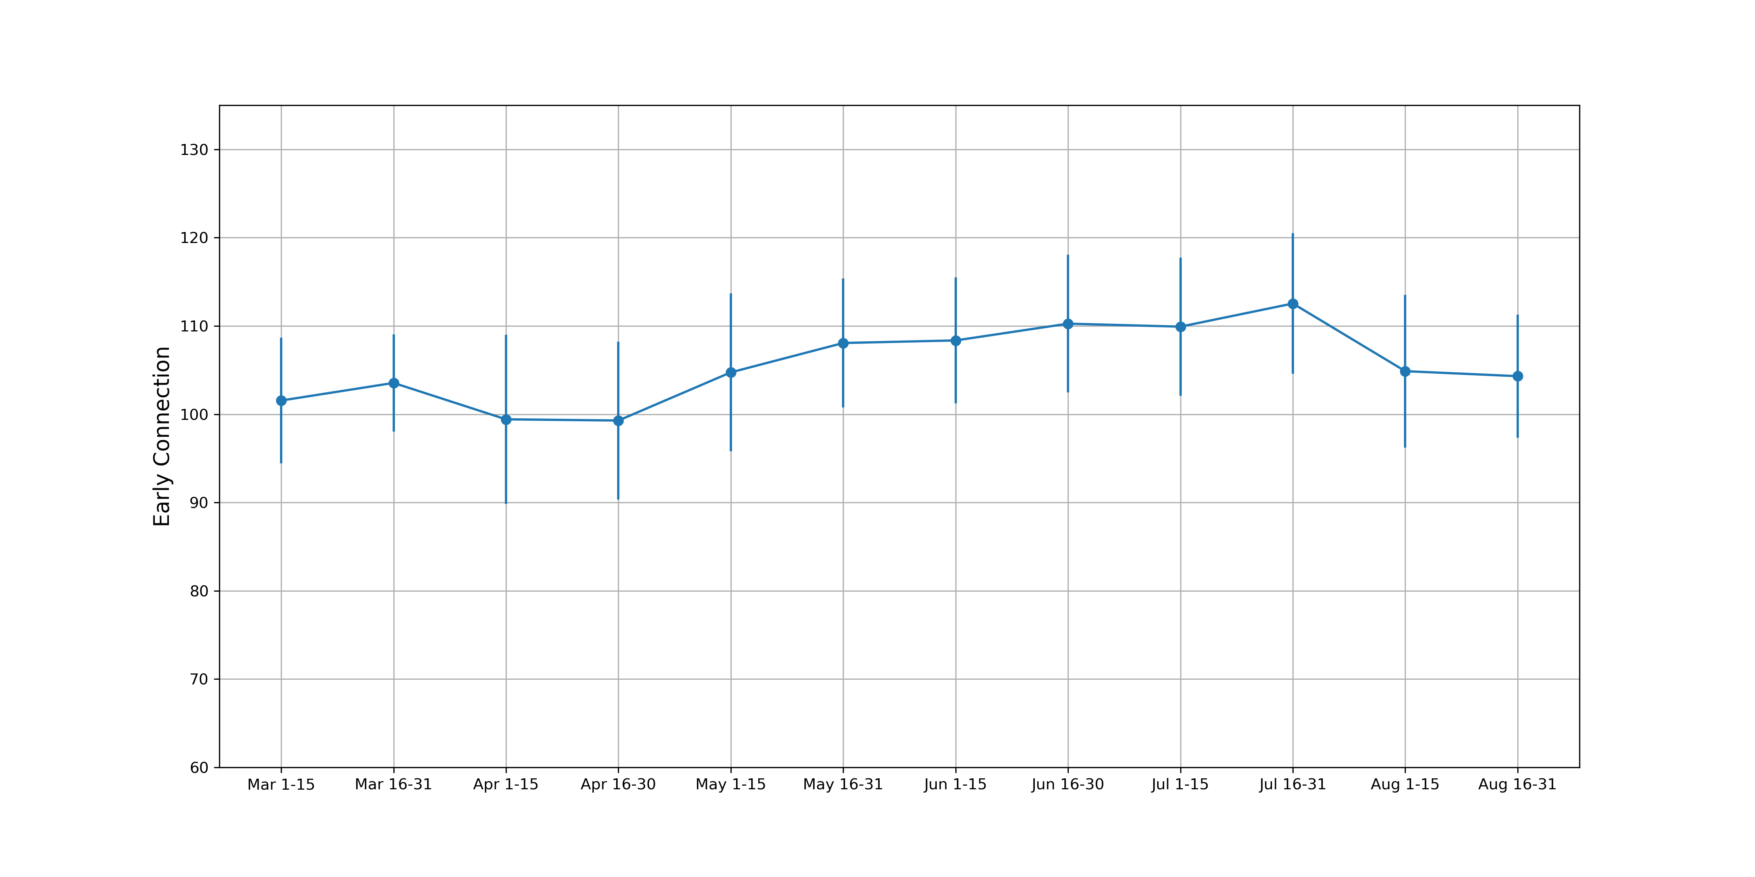
Connection Over a Season
80° – 105°
Notes:
Talk through application
Metaphor – Consistency in the load from week to week.

Slide 19
What Can Player Do …?
Add Context to Data
Know their data

Slide 20
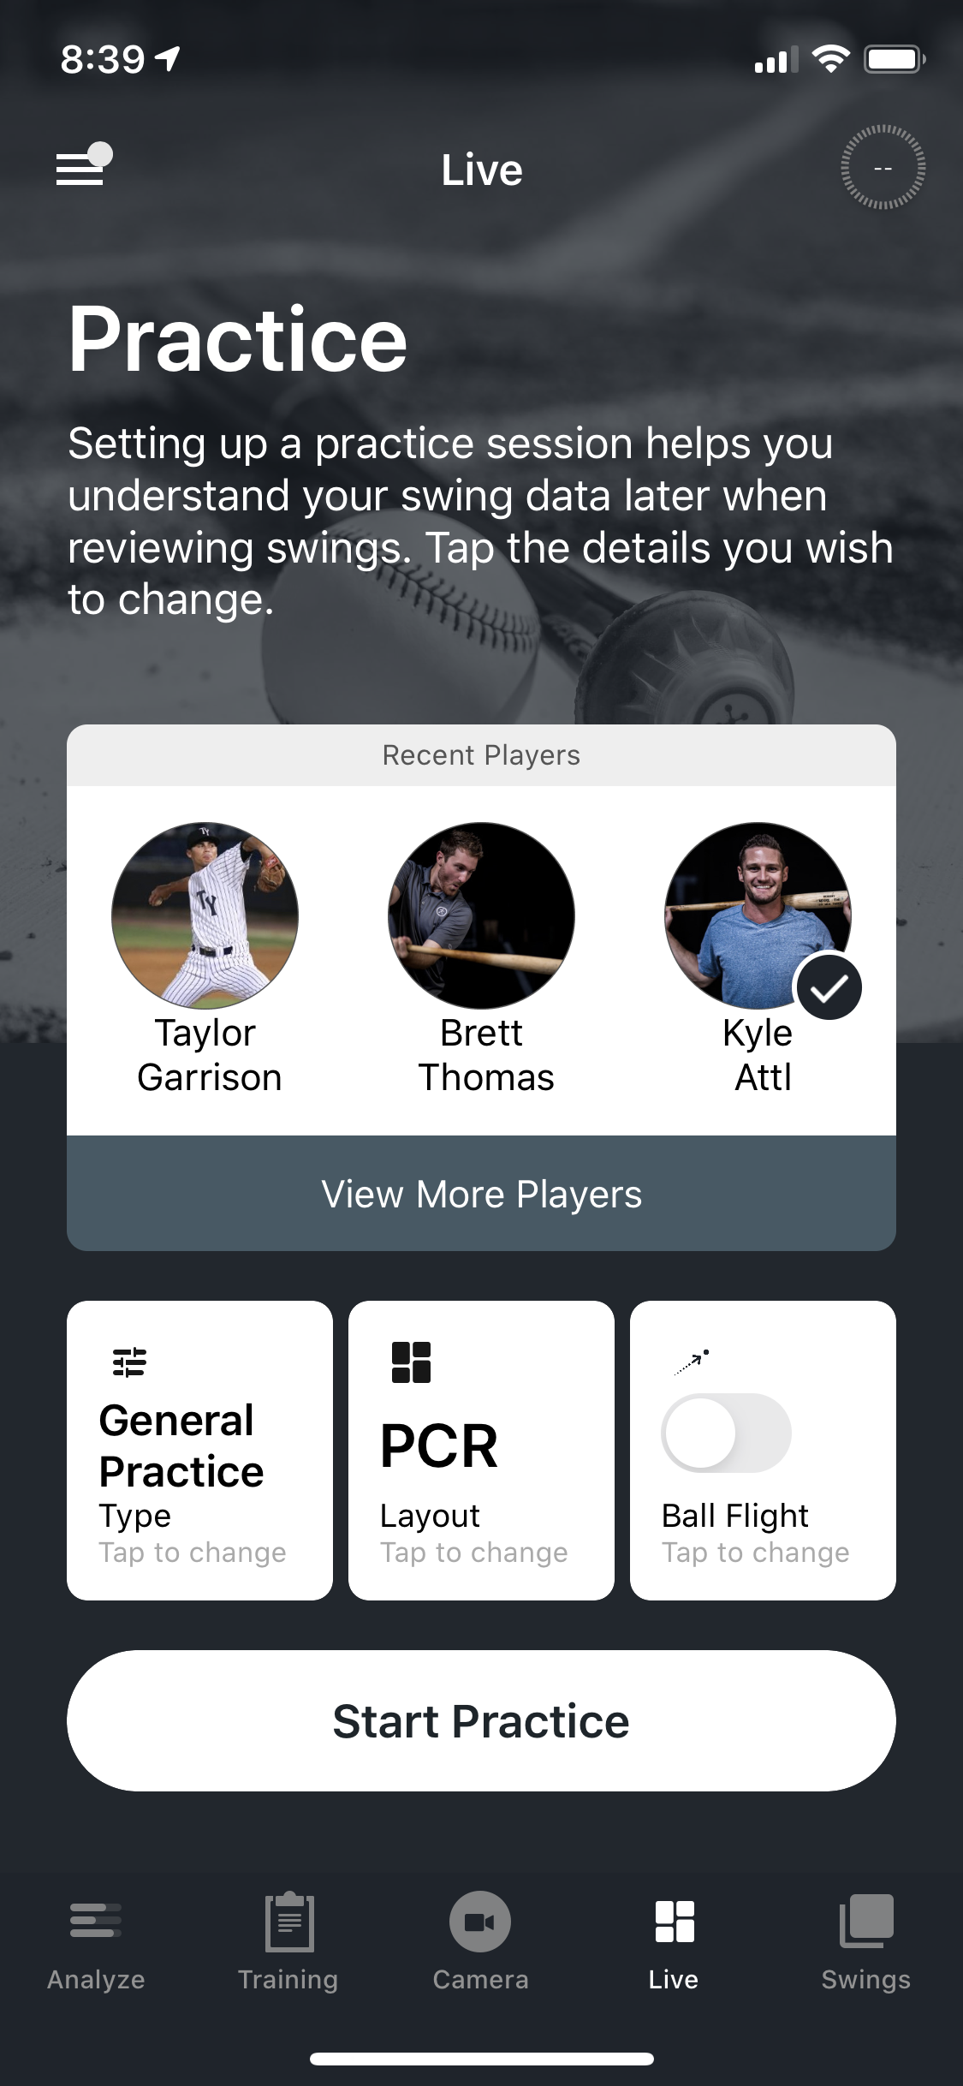
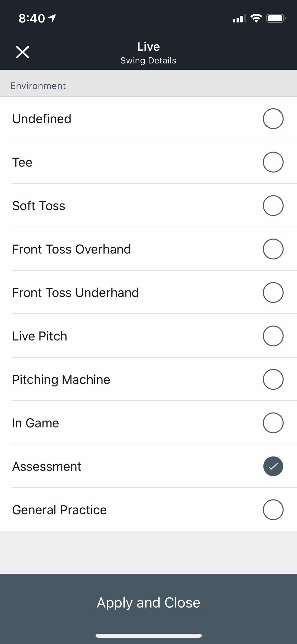
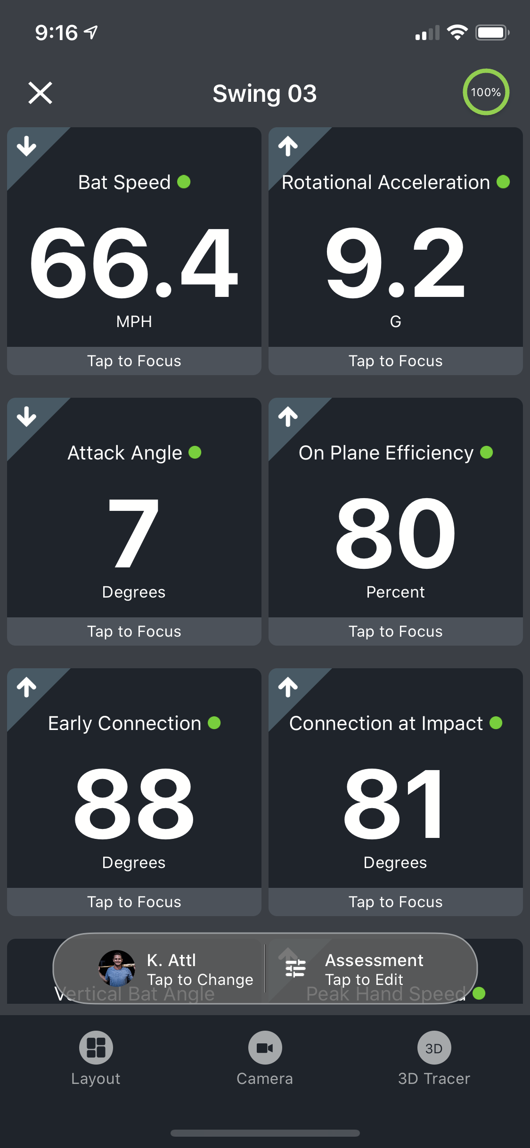
What to have player do …?
Notes:
1) This is an example of 2 hitters who have very similar bat speeds, but build them much differently (as seen by their Rotational Acceleration values)
2) The player with higher Rotational Acceleration (13 gs) builds the bat speed quicker and likely sequences better than the player with 6 gs of Rotational Acceleration
3) 2 cars can both be traveling at the same speed on the freeway (Bat speed), but how quickly they are able to acceleration from 0-60 is an indicator of their engine (Rotational Acceleration)

Slide 21
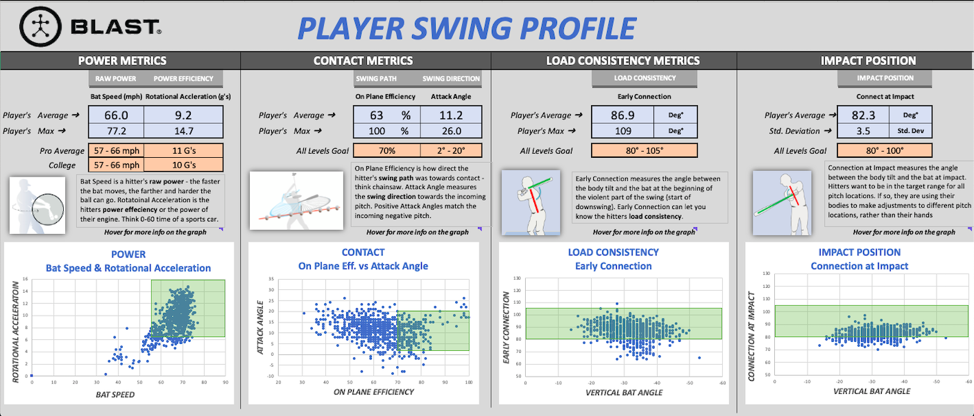
NO CONTEXT = PROBLEM

Slide 22
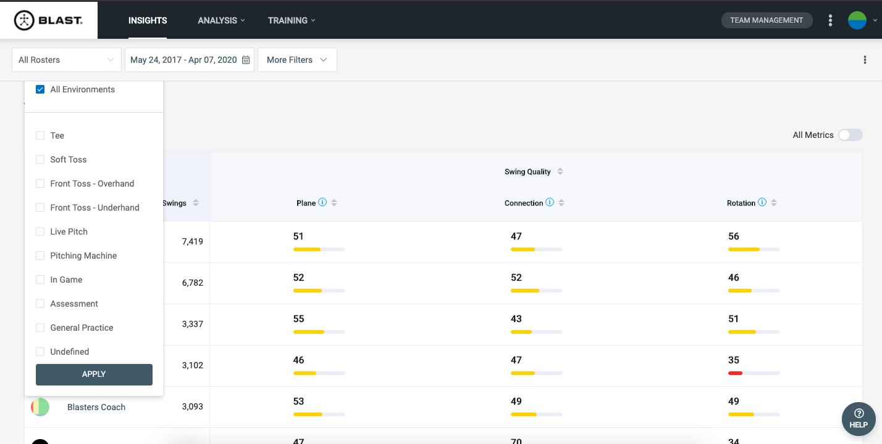
Blast Connect – Coach View

Slide 23
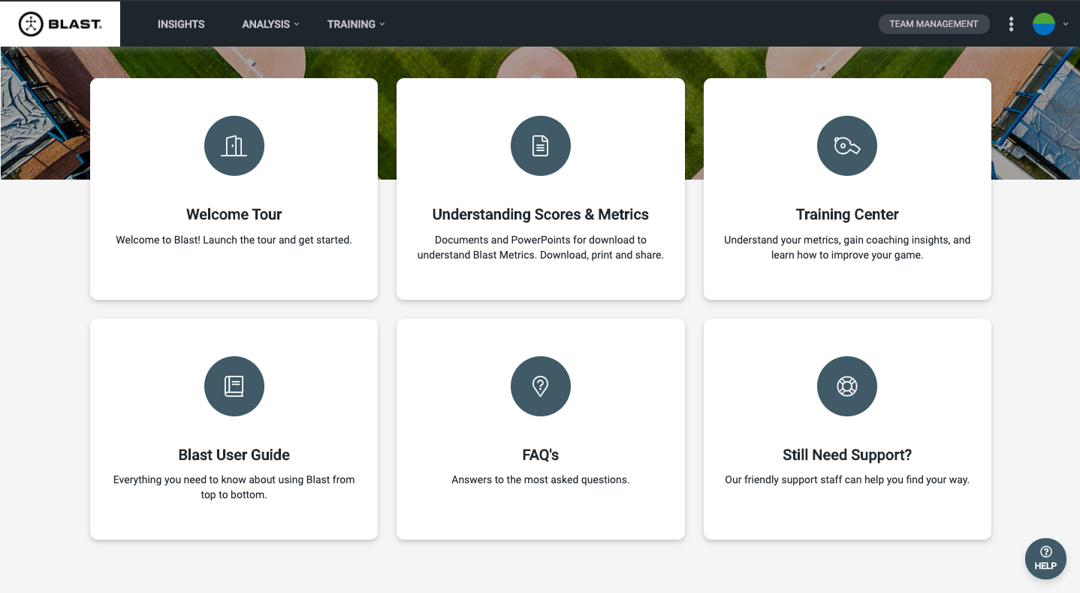
MORE INFORMATION …?

Slide 24
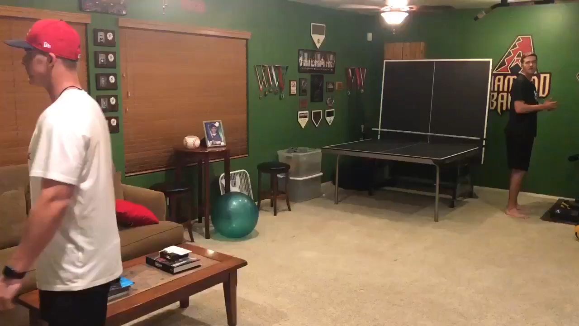
2 Sigma Athletes

Slide 25
My Metric Picks
Bat Speed
Early Connection
On-Plane Efficiency
Attack Angle
Rotational Acceleration

Slide 26
QUESTIONS …?
Twitter – @kyleattl
Email – kattl@blastmotion.com

